Slide 1
PARAMETRIC INSURANCE: Balance sheet protection come rain or shine
XI INTERNATIONAL RISK MANAGEMENT & INSURANCE SEMINAR
OCTOBER 2015

Slide 2
DISCLAIMER
This document is intended solely for the addressee and is strictly confidential in nature. By accepting this document, the recipient agrees not to disclose this information to third parties. Any reproduction and distribution, even partial, of this document in any form or by any means (electronic or otherwise) is strictly forbidden without the prior written consent of AXA CORPORATE SOLUTIONS.
This document has been prepared exclusively for informational purposes. It does not constitute a contractual element or advice. The information in the present document does not constitute an offer and should not be construed as legal, tax, or accounting advice by AXA CORPORATE SOLUTIONS. AXA CORPORATE SOLUTIONS cannot be held responsible for a decision based on this information and expressly disclaims any liability in connection with use of this document or its contents by any third party.
AXA CORPORATE SOLUTIONS, Limited Company registered in the Registre du Commerce et des Sociétés de Paris under the number 399 227 354, with headquarters at 4 rue Jules Lefebvre – 75 009 Paris (France).

Slide 3
1
Parametric Insurance:
A growing need in the face of
climate change

Slide 4
Climate change affects us all
“Climate Change warrants AXA’s attention because both the science and the economics are crystal clear: we have no choice: a 2 ºC world might be insurable, a 4 ºC world certainly would not be.”
Henri de Castries,
Chairman and CEO of AXA Group
x5
x10
20%
Increase in the frequency of weather anomalies over the past 50 years¹
Cost for society²
The overall cost of risks associated with climate change represents between 5% and 20% of GDP³
¹World Health Organization, GIEC
²EM DAT Database
³Stern Report

Slide 5
Last time temperatures were as hot as 2014 was over 50,000 years ago….
What we may have looked like during the Paleolithic era…

Slide 6
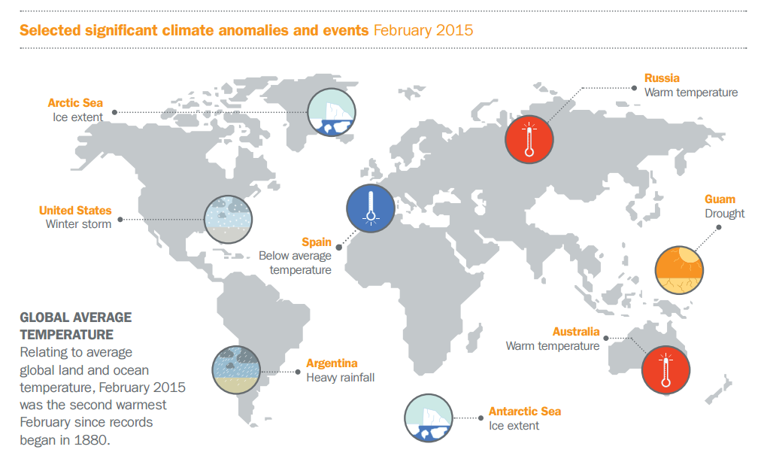
Today, we are experiencing many weather anomalies across the globe…

Slide 7
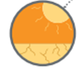
… and Brazil is not immune to these anomalies
2014: Flooding
In 2014, the Rio Madeira, the largest tributary of the Amazon, reached record levels and caused the worst flooding for a century
2015:
Drought & Energy
Seventeen of the country’s 18 biggest reservoirs are at lower levels than during the last water crisis in 2001. The southeast is worst affected. This can impact hydroenergy generation, which makes up 70% of Brazil’s electricity
2015: Drought & Agriculture
Production of Arabica coffee beans fell by 15% last year, pushing the global price of the commodity by almost half
¹All info from The Guardian
Notes:
2015 Drought in Brazil
“Agriculture is suffering with international impacts. Production of arabica coffee beans – a commodity that Brazil supplies in far greater bulk than any other country – fell 15% last year pushing up the global price of the commodity by almost half.”
As coffee has a two-year growing cycle, the impacts will be felt next year too even if the rains return. Sugar and ethanol output has also been hit. Last week, Raizen, the country’s biggest producer,announced it will lay off 250 workers and cease production at its Bom Retiro mill for two years because of cane shortages caused by the drought.
Seventeen of the country’s 18 biggest reservoirs are at lower levels than during the last water crisis in 2001. The southeast is worst affected.
Regions most affected are Sao Paulo, Rio de Janeiro and Minas Gerais
Effect on hydroenergy generation: as seventy percent of Brazil’s electricity is generated by hydropower, there is concern that lack of water may also lead to energy rationing in addition to water rationing.

Slide 8
2
Introduction to AXA’s Parametric Insurance department

Slide 9
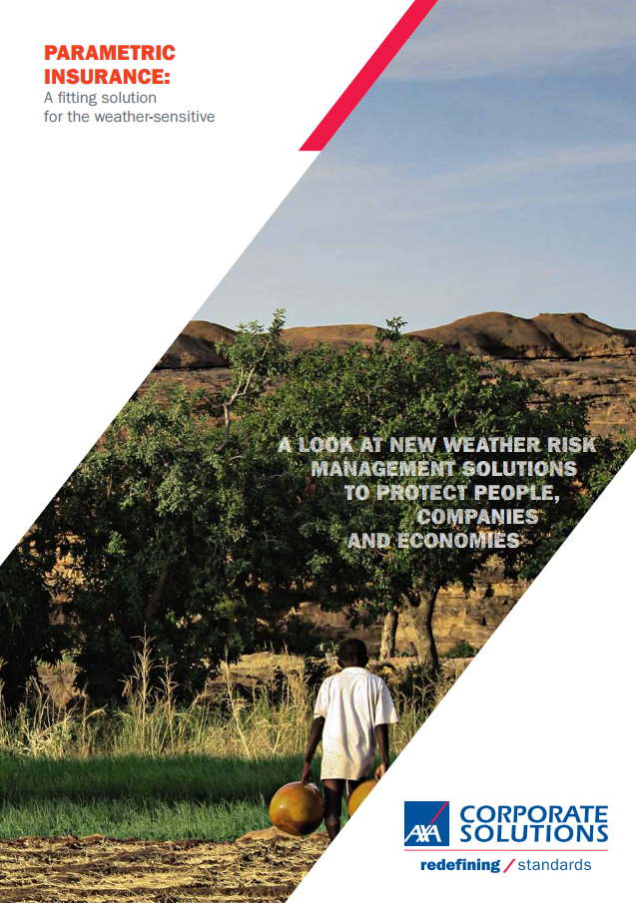
In 2014, AXA CS launched a department dedicated to parametric insurance
This new insurance product covers many different industries against weather-related risks
We currently work in 17 countries across the globe
There are many weather indexes possible including rainfall, temperature, crop yield, wind speed wave height, and more
The indexes are based on the newest technology from weather stations and satellite imagery
We use AXA’s Data Innovation Lab to process large amounts of data
We have 2 main client segments:
1. Public-Private Partnerships
2. Large Corporations

Slide 10
PPP: AXA CS is working with the World Bank and the ARC to develop innovative parametric insurance solutions in emerging markets
In FEBRUARY 2015, AXA CS Signed a partnership with the Global index insurance facility (GIIF) of the world bank group
In MAY 2015, AXA CS joined THE AFRICAN RISK CAPACITY
+
+

Slide 11
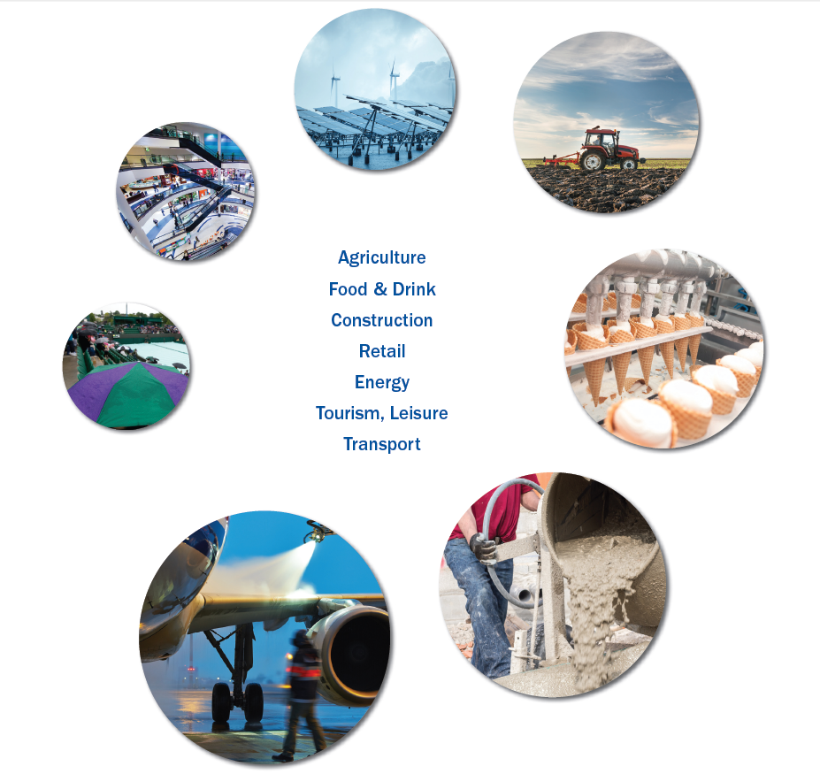
Large corporate segment: many industries are impacted
Allianz’ focus today
LACK OF WIND/SUN:
DECREASED PRODUCTION OF RENEWABLE ENERGY
EXCESS RAIN AND DROUGHTS: DIRECT IMPACT ON AGRICULTURAL YIELDS, RESULTING IN SEVERE FAMINES
AXA’s focus
today
CHILLY SUMMER: CAN CAUSE DECREASE IN SUMMER CLOTHING SALES
Agriculture
Food & Drink
Construction
Retail
Energy
Tourism
Transport
WARM SPRING: DECREASE IN BOOKING VACATIONS ABROAD AS PEOPLE WOULD RATHER STAY HOME
CHILLY SUMMER: CAN CAUSE SALES OF SOFT DRINKS TO PLUMMET DUE TO LESS STORE/RESTAURANT VISITS
COLD AND SNOWY: IN THE AIRLINE INDUSTRY, CAUSES FLIGHT DELAYS AND CANCELLATIONS, AND REQUIRES DE-ICING PRODUCTS
WET/COLD: CAN CAUSE WORK INTERRUPTIONS, DELAYS IN POURING CEMENT

Slide 12
How does Parametric Insurance work?
Parametric insurance fundamentals
Based on the use of a parameter (typically rainfall or temperature) that is correlated to the client’s loss (e.g. decrease in revenues or profitability)
Payment amount is fixed in advance in the insurance contract
Cover: design of an insurance adapted to the needs of the company
ANALYSIS
COVER
PAYMENT
Analysis of the company’s weather vulnerability
Payment: payment triggered within a few days and based on certified weather data (a proof of loss may be required in some cases)

Slide 13
3
Parametric Insurance:
Where are we coming from and
where are we headed?

Slide 14
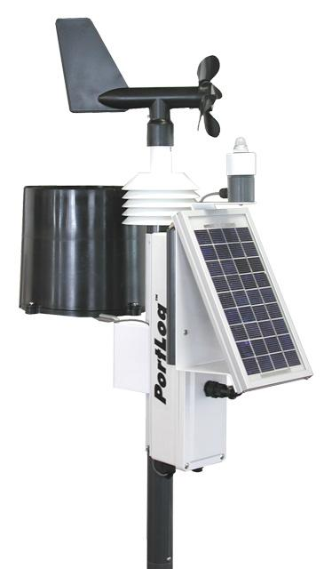
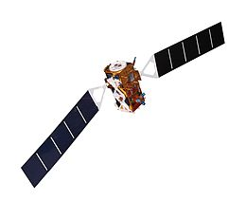
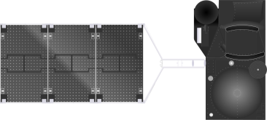
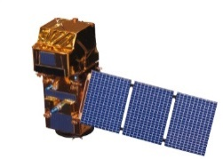
Improvements in technology have pushed the development of parametric insurance
MID-2000S
END 2000S
SINCE 2010S
First pilots with weather stations
Data that allows for construction of indices but with a high basis risk
Use of satellite imagery
New data available through satellite imagery and allowing to compensate for lack of granularity
Data science
Big Data revolution helps us design the most appropriate insurance products
Focus of next slides

Slide 15
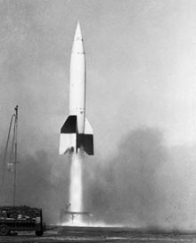
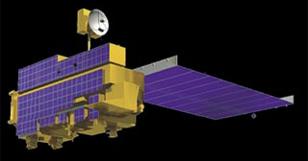
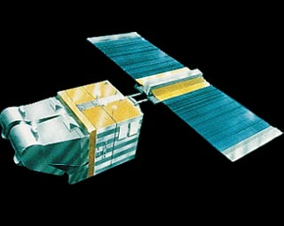
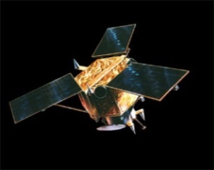
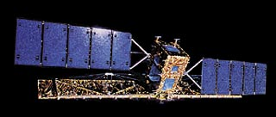
Some images from satellites launched in the 70s are still used today…
1975
Balloon-view
GOES
1858
Space-view
1946
1999
TERRA
1986
SPOT
1850
1940
1950
1960
1970
1980
1990
2000s …
1960
2000
TIROS-1
IKONOS
1972
LANDSAT
1995
RADARSAT
Images still used today for monitoring food security

Slide 16
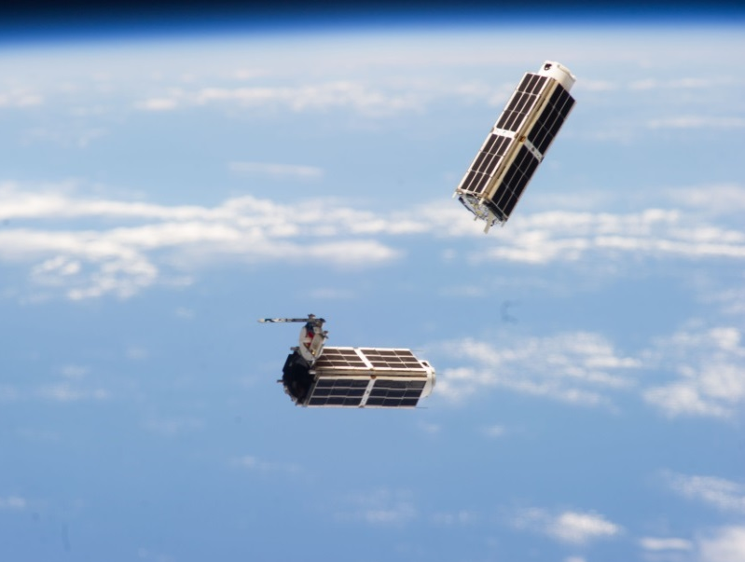
Even more granular data will be available in the future
“Sentinel” Satellites
“Dove” satellites
New information such as land vegetation and plant health
More frequent and granular data
Source: ESA and Planet Labs websites

Slide 17
4
Case studies for index insurance

Slide 18
What types of indexes can we build?
ICE COVER
WAVE HEIGHT
SNOWFALL
Our focus today
PLANT HEALTH
AREA YIELD
RAINFALL ESTIMATE
SOIL MOISTURE
WIND SPEED
TEMPERATURE
Many different types of indexes can be built. Today’s focus will be on those specific to agriculture…
Notes:
To give you an idea of the different types of indexes that can be used, here are 9 examples…
Let’s take a look at plant health, an index typically used for agriculture.

Slide 19
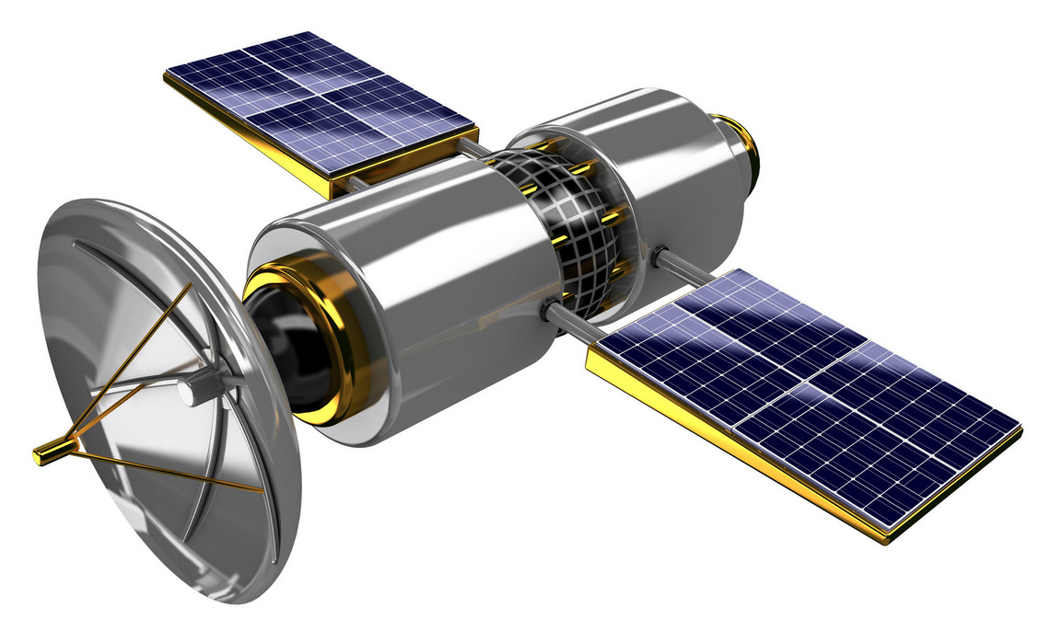
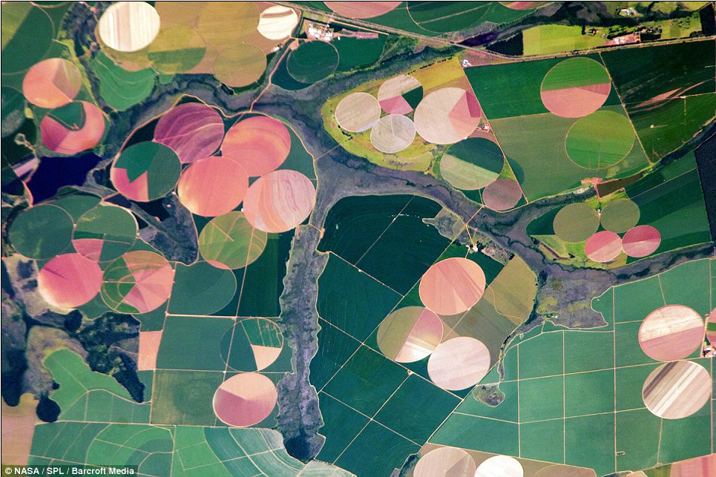
Demo: Crops Near São Paulo
Vegetation Index

Slide 20
Field to
be
insured

Slide 21
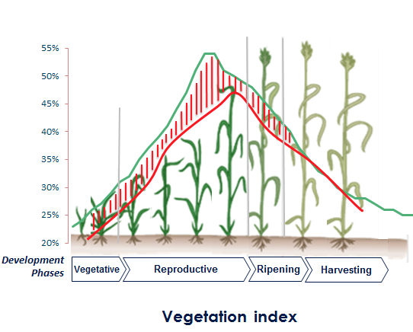
We insure a deviation compared to the 10-year average
Vegetation index
Healthy Vegetation reflectance
NDVI=0.72
Stressed Vegetation reflectance
NDVI=0.14

Slide 22
Area-yield is another approach typically used to cover commodity traders
Elements to communicate to the broker and insurer:
Planted surfaces
Expected yield
Insured margin per ton or price per ton
Choice of reference yield (e.g.: average of the last 5 years)
Desired deductibles and limit
2015 Campaign | Crop : Winter Wheat
 | Surface (ha) | 20 000
 | Insured margin (€/t) | 20
 | Capital insured (€) | 16 000 000
 | Limit (%) | 30%
 | Deductible (%) | 10%
 | Official yield reference (t/ha) | 4.5
Claims settlement
June 2016 settlement | Crop : Winter Wheat
 | Official yield 2015 | 3.9
 | Yield difference (%) | -13.3%
 | Indemnity (€) | 528 000
Calculation of net indemnity following the publication of results¹
Claims settlement
Possibility of down payment after semi-definitive results
¹ Figures provided by an official statisticial body (AGRESTE in France, IBGE in Brazil,…)
Notes:
To change the color of bar diagrams (like any graphical element), click on the item you want to modify, and change the color using the Fill icon from the Format tab.

Slide 23
Concluding remarks and questions
Parametric insurance is an innovative solution to protect the weather-sensitive against the financial consequences of weather anomalies
Insurers work hand-in-hand with brokers to provide the most adequate, tailor-made solution to clients in many different sectors
Today, thanks to improvements in technology, we are confident that parametric insurance will continue to develop in the future, notably in terms of:
Field of application
Types of risks insured
Geography
Questions?

