Slide 1
XI Seminário Internacional de GERÊNCIA DE RISCO E SEGUROS
26 Outubro 2015

Slide 2
TYPICAL QUESTIONS CFOS FROM MULTILATINAS ARE ASKING TO THEIR RISK MANAGERS
$
WHY WE BUY INSURANCE?
Why we need to by global programs and for which lines?
Do we understand how economic, legal, and fiscal trends impact my industry and affect long-and short-term risk strategies?
HOW MUCH RISK CAN MY COMPANY TOLERATE?
What are our company’s sources of capital and how do we prefer to deploy those resources to deal with unexpected losses?

Slide 3

TYPICAL QUESTIONS CFOS FROM MULTILATINAS
ARE ASKING TO THEIR RISK MANAGERS
IS MY COMPANY ADEQUATELY PROTECTED AGAINST RISK?
Are my company’s limits and deductibles appropriate?
Do my insurance structure reflect corporate risk tolerance?
IS MY REGIONAL PROGRAM IS GETTING THE EXPECTED VALUE FROM ITS INSURANCE PURCHASE?
How my program is priced and how can I benefit from economies of scale (regional programs)
Cost of retaining risk vs. cost of transferring risk (premium)?
Whose capital is cheaper: my company’s or your insurance carrier’s?

Slide 4

How some multilatinas are leveraging data and analytics to improve their risk management strategy and cost reduction efforts?
EXCELLENCE IN RISK MANAGEMENT SURVEY
74%
of the respondents said their organization need to make a deeper analysis of their risk-related data
79%
of insurers are simulating internal risks to satisfy regulatory requirements.

Slide 5

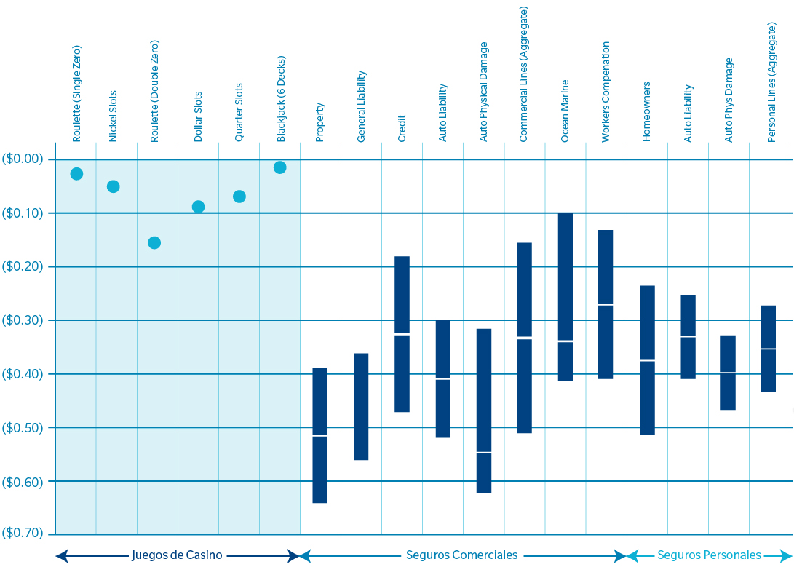
WHY WE BUY INSURANCE?
$
Comparison between casinos and insurance.
Average return for every $1 spent

Slide 6
$
WHY WE BUY INSURANCE?
Comparison between casinos and insurance.
Average return for every $1 spent
“
The amount of losses at any one company fluctuates unpredictably from year to year. In fact, this uncertainty is the main reason that companies buy insurance and create loss control and mitigation programs
”
Claude Yoder and Dave Heppen, CFO Magazine
Notes:
The framework that we use to analyze risk financing decisions is called Risk Financing Optimization
Here, we are trying to answer two key questions:
Is the company adequately protected within its risk tolerance?
Is the company getting a good deal for its insurance purchases?
These are the questions we want our clients to be prepared to answer to their senior management and board of directors.

Slide 7
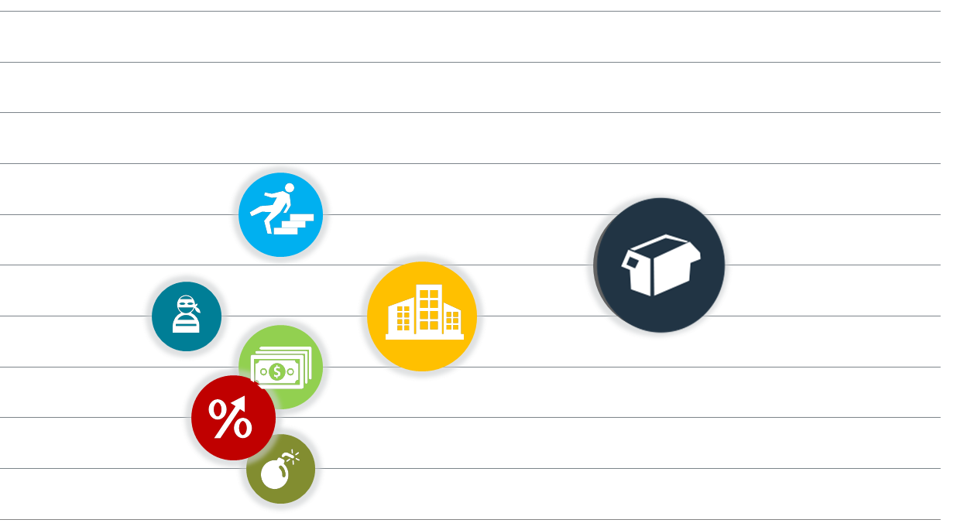
WHY WE BUY INSURANCE?
$
Do we need to buy insurance and for which lines?
Risks that similar companies are facing. Which are my signature risks?
10
9
8
7
6
5
4
3
2
1
0
Frequency
1 2 3 4 5 6 7 8 9 10
Severity

Slide 8
HOW MUCH RISK CAN MY COMPANY TOLERATE?
What are your company’s sources of capital and how do you prefer to deploy those resources to deal with unexpected losses?
Earnings Miss the equity holders’ view
Arrives at an earnings miss that might cause a drop in share value
Estimates the volatility built into earnings estimates
Typically discounts intangible assets
Debt Coverage The Bondholders’ View
Looks at earnings miss required for one or more notch rating downgrade(s)
Emphasis on interest coverage
Might look at other loan covenants
Key Performance Indicators (KPIs) Qualitative View
KPIs are selected from:
Balance sheet
Income statement
Access to other funds
Flexibility allows for reflection of company culture
Appropriate for private companies

Slide 9
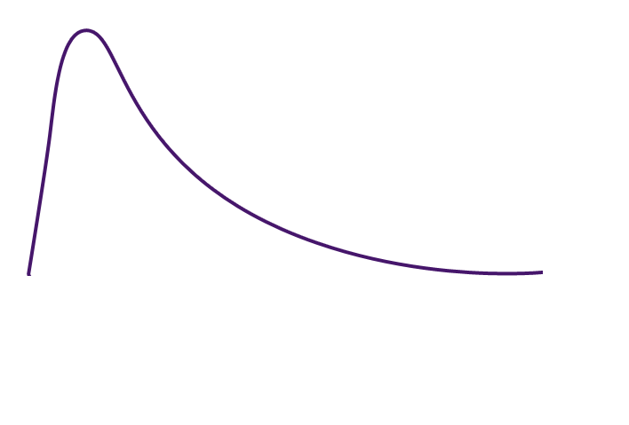

IS MY COMPANY ADEQUATELY PROTECTED AGAINST RISK?
Are my company’s limits and deductibles appropriate?
Do my insurance structure reflect corporate risk tolerance?
Retained Loss
Insured Loss
Uninsured Losses
= WACC* Unexpected Losses
Frequency
Severity

Slide 10
IS MY COMPANY ADEQUATELY PROTECTED AGAINST RISK GLOBALLY?
How my program is priced and how can I benefit
from economies of scale (regional programs)
Cost of retaining risk vs. cost of transferring risk (premium)?
Whose capital is cheaper: my company’s or your insurance carrier’s?
Key Statistics |  | Before Insurance | Retained After Insurance | (Cost) / Benefit
Average Annual Losses |  | 5,506,858 | 3,780,731 | 726,127
Standard Deviation |  | 23,875,866 | 13,111,817
Coefficient of Variation |  | 5.30 | 3.40
1 in 1.33 Years | 25% Perc | 0 | 3,020,342 | -3,020,342
1 in 2 Years | 50% Perc | 0 | 3,020,342 | -3,020,342
1 in 4 Years | 75% Perc | 0 | 3,020,342 | -3,020,342
1 in 10 Years | 90% Perc | 1,619,223 | 3,270,342 | -1,651,119
1 in 100 Years | 99% Perc | 85,679,570 | 3,520,342 | 82,159,228
1 in 250 Years | 99.6% Perc | 151,915,728 | 34,936,070 | 116,979,658
Insurance looks like only a cost when you don’t have losses
Insurance begins to pay off
Substantial benefit, multiples of premium paid
ECONOMIC COST OF RISK (ECOR)
SIGN | COMPONENTS | NO INSURANCE | CURRENT PROGRAM | OPTION A | Option B
+ | Discounted Average Retained Losses | 5,146,309 | 3,402,658 | 3,814,605 | 3,938,994
+ | Premium | 0 | 3,020,342 | 2,416,274 | 2,265,257
+ | Financial cost of unexpected losses | 2,036,577 | 510,399 | 572,191 | 669,629
+ | Collateral and Other Admin Costs | 110,000 | 45,000 | 57,000 | 70,000
= | Economic Cost of Risk | 7,292,886 | 6,978,399 | 6,860,070 | 6,943,880
Optimized Program

Slide 11
IS MY COMPANY ADEQUATELY PROTECTED AGAINST RISK GLOBALLY?
How my program is priced and how can I benefit
from economies of scale (regional programs)
Cost of retaining risk vs. cost of transferring risk (premium)?
Whose capital is cheaper: my company’s or your insurance carrier’s?
“
Carriers may no longer need to compete on price; they instead may be able to assess the risk of individual customers based on their actual behaviors
”
Business Insurance

Slide 12
THE EVOLVING ROLE OF THE RISK MANAGER
RISK MANAGEMENT
“Is a business discipline that protects assets, earning stream and profits of an organization by preventing potential losses before they occur, and executing a prompt recovery after losses occur”
Traditional/ Defensive | Integrated/ Advanced | ERM
Silo ad hoc approach Focus on transferring Risks Protect balance sheet though Insurance Hedging Indemnifications Hazard Based Not Linked to company strategy | Business Risk Approach Mitigate controllable risk Prevent Reduce frequency Reduce severity Focus on lowering insurance costs and retained losses Collaborative cross-silo interactions Linked to corporate strategy through event risks and financial objectives | Portfolio approach Risk based business decisions across the organization Address potential devastating threats and weaknesses Exploit opportunities and strengths Manage unwanted variations from expected outcomes Integrated into strategic planning, operational planning and day to day activities
Source: RIMS

Slide 13
XI Seminário Internacional de GERÊNCIA DE RISCO E SEGUROS
26 Outubro 2015

